Slide 1
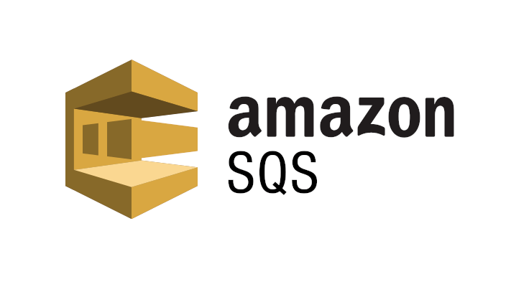

Slide 2

Topics
What is Amazon SQS
Type of SQS
Exam Tip

Slide 3


What is Amazon SQS?
Amazon SQS a web service that gives you access to a message queue that can be used to store messages while waiting for a computer to process them.
It is distributed queue system that enables web service applications to quickly and reliably queue messages that one component in the application generates to be consumed by another component.
A queue is a temporary repository for messages that are awaiting processing.

Slide 4





Amazon SQS
Let’s party

Slide 5


Amazon SQS

Slide 6

What is Amazon SQS?
Using Amazon SQS, you can decouple the components of an application, so they run independently, easing message management between components.
If you notice that word decouple in the exam, just think straight to SQS because that's were SQS comes in picture
Any component of a distributed application can store messages in a fail-safe queue
Messages can contain up to 256 kilobytes of text in any format.
Any component can later retrieve the messages programmatically using the Amazon SQS API

Slide 7
What is Amazon SQS?
The queue acts as a buffer between components producing and saving data and the component receiving the data for processing.
This means that the queue resolves issues that arise if the producer is producing work faster than the consumer can process it or if the producer or consumer are only intermittently connected to the network
There are two types of queue:
Standard queues
FIFO queues

Slide 8
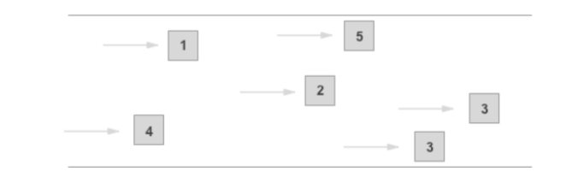
Standard queues
Standard queue are default queue type. A standard queue lets you have nearly-unlimited number of transactions per second.
Standard queues guarantee that a message is delivered at least once.
Occasionally because of the highly distributed architecture that allows the high throughput more than one copy of the message might be delivered out of order.
However, standard queue provide best-effort ordering which ensures that messages are generally delivered in the same order that they're sent.

Slide 9
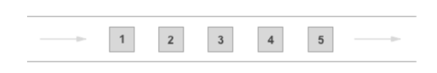
FIFO queue
The most important feature of this queue type are FIFO(first-in-first-out) delivery and exactly-once processing ,the order in which the messages is sent and received is strictly preserved and a message is delivered once and remains available until a consumer processes and deletes it.
Duplicates are not introduced into the queue.
FIFO queues also support message groups that allow multiple ordered message groups within a single queue.
FIFO queues are limited to 300 transactions per second (TPS) but have all the capabilities of standard queues.

Slide 10
Exam Tips:
SQS is pull-base, not pushed-based.
Messages are 256KB in size.
Messages can be kept in queue from 1 minute to 14 days, the default retention period is 4 days.

Slide 11
Exam Tips:
Visibility time out is the amount of time that the messages is invisible in the SQS queue after a reader picks up that message.
Provided the job is processed before the visibility time out expires, the message will then be deleted from the queue.
However, if the job is not processed within that time, the message will become visible again and another reader will process it. This could result in the same message being delivered twice.
Visibility timeout maximum is 12 hours

Slide 12
Exam Tips:
SQS guarantees that your messages will be processed at least once.
Amazon SQS long polling is a way to retrieve messages from your SQS queue.
While the regular short polling returns immediately.
Even if the message queue being polled is empty long polling doesn't return a response until messages arrive in the message queue or the long pole times out.
Any time you see a scenario bases question about "decoupling" your infrastructure - think SQS directly

Slide 13
Thank you

